Slide 1

PhD Pre-Confirmation Meeting
DD NN December 2019
Peter Donnelly
peter.donnelly@petermac.org
Illustrating Convex Optimization, the mathematical basis of neural networks
Image: https://www.matroid.com/blog/post/the-hard-thing-about-deep-learning

Slide 2
“Improving Classification of T-Cell Lymphomas By Applying Machine Learning to Dual Heterogeneous Data Sources"

Slide 3


Thesis Title & Objective
Improving Classification of T-Cell Lymphomas By Applying Machine Learning to Dual Heterogeneous Data Sources
Use both digitised slide images and gene expression data to try to improve classification of difficult to differentiate subtypes
One or more Machine Learning models will be developed as part of the thesis
The selection, development and documentation of models, toolchains, processes, validation techniques and statistical analyses will constitute a major element of the PhD

Slide 4



Questions
Might a Machine Learning algorithm be able to improve our ability to classify Peripheral T-Cell Lymphomas, a type of cancer which Pathologists frequently find challenging to classify?
Might training an ML model using two heterogeneous data types (specifically, morphology + gene expression data):
  Improve cancer classification outcomes compared with using
  either alone?
  reduce the quantity of labelled examples necessary to achieve a similar level of classification outcome compared to using image data alone?
What processes, toolchains and machine learning models are best suited to achieving the above ?
Top image: “A Pathologist’s Guide to Accurate Diagnosis of Peripheral T-Cell Lymphonas” on Medscape
Lower two images: “End-to-end Training of Deep Probabilistic CCA on Paired Biomedical Observations” (Gunderson et all, NIPS 2018)

Slide 5




Assumptions
Experienced pathologists can find it challenging to differentiate some lymphoma subtypes even with top quality H&E slides. Inter- and Intra-pathologist variability is high for some subtypes
Gene expression testing (Microarrays, RNASeq, Nanostring) will ultimately become completely routine clinical tests for cancer patients. Only the timing is in question.
Ultimately, manual labelling will not be sustainable due to the enormous volumes of images and data which are now and will be generated.
Publicly accessible labelled WSI and genomic datasets have passed the threshold of viability for Machine Learning, and will only become more extensive and useful with time. TCGA in particular, but also others
`
Top image: “A Pathologist’s Guide to Accurate Diagnosis of Peripheral T-Cell Lymphonas”
Middle image: Nanostring website
Botton image: NIH GDC Data Portal

Slide 6
Thesis Aims
Aim 1
Aim 2
Aim 3
By iteratively developing and implementing one or more Machine Learning systems ...
… Test and quantify and discuss the efficacy of ML classification of Lymphomas:
(Primary Objective)
(Primary Objective)
… using WSI image data alone and gene expression data alone (RNASeq or Nanostring gene expression data)
… using both WSI image data and gene expression data (RNASeq or Nanostring gene expression data)
… with publicy available WSI datasets (esp. TCGA and Camelyon)or PMCC B Cell project data to establish baseline learning model
… with PMCC clinical data
Document the toolchains and models used in pursuit of the above; and make these freely available to the broader research community via github or docker hub or similar
(Secondary Objective)
Quantify the extent (if any) to which using two data modes reduces the number of training examples required compared to image data alone
(Preferred outcome)
(Preferred outcome)
(Preferred outcome)
ESTABLISH
BASELINE TOOLCHAIN
TEST ‘DUAL DATA’
HYPOTHESIS
CLASSIFY
TCLs
ESTABLISH
BASELINE MODEL

Slide 7
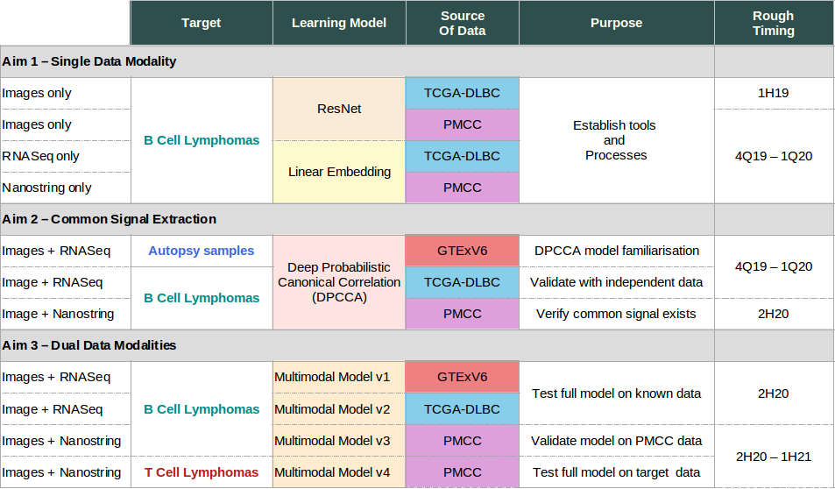
Project Plan

Slide 8
Work to Date
Acquiring Relevant Domain Knowledge
  Cell biology and cancer genomics (reading and lectures)
  Cancer Pathology Processes
    Learning about PMCC roles, workflows and systems
    Gene Sequencing & Curation (reading, interviews, lectures)
  Histopathology (reading and lectures)
Establishing and methodically using reference management system (Zotero based)
ML Infrastructure
  Home Environment: for learning and rapid model development / tweaking
  AWS (Cloud) P3 Spot Instances: for large scale learning
  PMCC ML facility
Deep Dives into relevant contemporary ML algorithms, models, techniques including
  Convolutional Neural Networks
  Long Short Term Memory (LSTM) RNN networks and Attention Models
  Transformer Models, in particular Google Brain’s Tensor2Tensor Model
  Word Embedding (eg. Word2Vec, Glove …)
Trying out and existing relevant ML applications
  Analysis of cancer pathology samples using CNN (‘QUIP’)
  Text Summarization using LSTM (model: ‘Long-Summarization’)
  Reinforcement models (Tensorflow examples)
  Transformer models (Google Brain‘Tensor2Tensor)
Locating and experimenting with useful tools and datasets
  digitally accessible portions of the literature (PubMed Central)
  WSI datasets (TCGA)
  well known & best practice datasets (e.g. TCGA WSIs, gene and drug ontologies)…
Circumscribing and homing in on a tractable problem (subsequent slides)
  Relevant, Achievable, Interesting, Reasonable likelihood of success

Slide 9
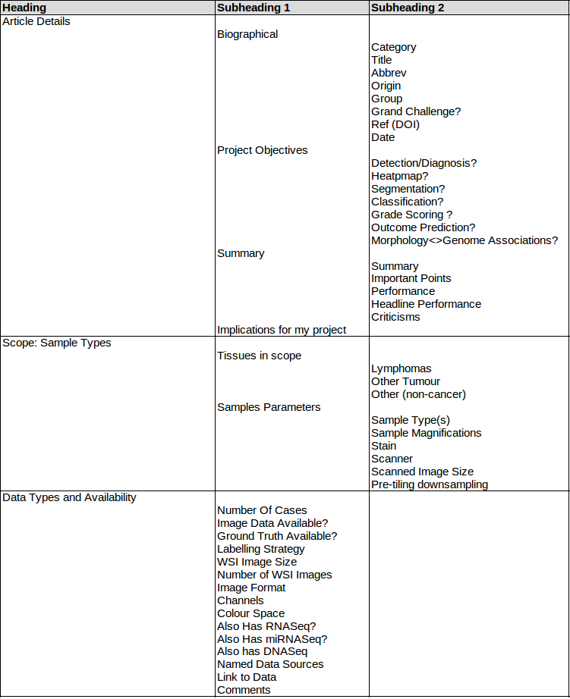
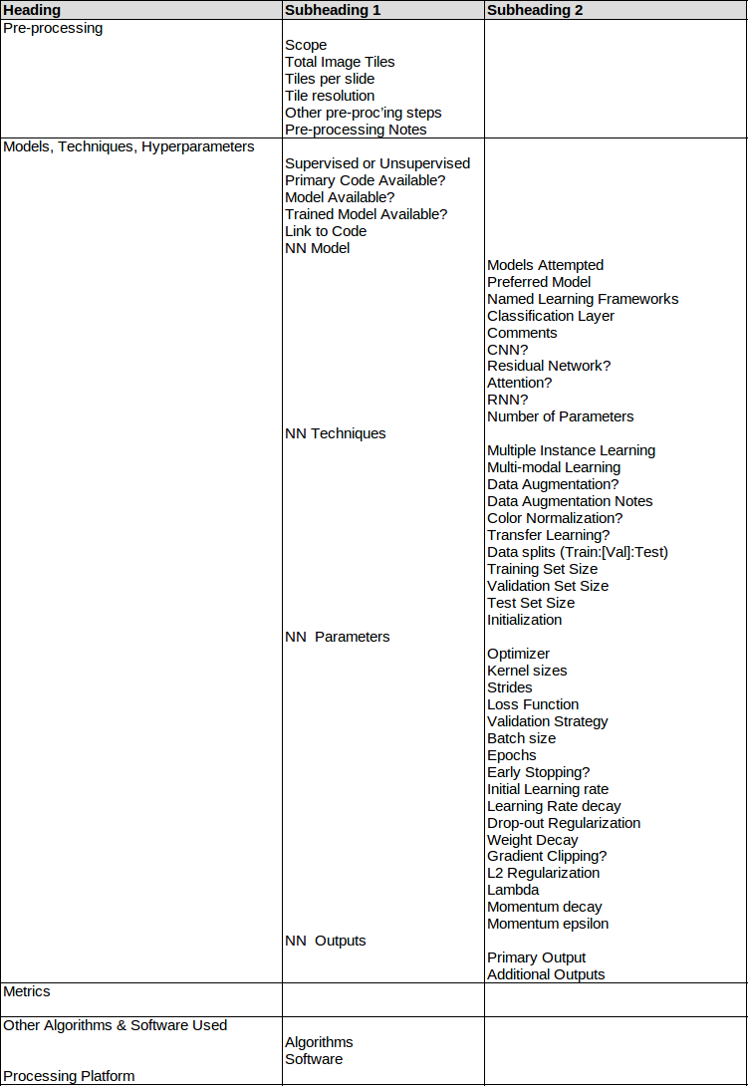
Structured Review of Relevant Papers

Slide 10
Observation:
Numbers of Images Used Vary from 400 to 45,000

Slide 11

Public Datasets
TCGA (The Cancer Genome Atlas)
  “many large data sets are indeed large collections of small data sets”
  53 projects, 30,287 WSI, 138,405 Gene Expression
  DLBCL: 2 projects, 118 cases:
    CCLE-DLBC: 58 cases; RNASeq data only
    TCGA-DLBC: 60 cases; rich mix of data modalities
      59 WSI; 384 RNASeq; 251 miRNASeq, 243 DNASeq; 192 DNA Meth (and more)
NIH National Institute on Aging IICBU Biological Image Repository
  375 Malignant Lymphoma images (Brightfield; TIFF; 1388x1040x32)
CAMELYON16/17 ( ‘Cancer Metastases in Lymph Nodes Challenge’)
  “grand challenge with the largest histopathology dataset publicly available: 1399 WSI and around 3 terabytes”
  Nodal Metastases (no Lymphoma)
  Pcam (‘PatchCamelyon’)
    Dataset derived from Camelyon consisting of 327.680 96x96 images extracted from Camelyon, each annoted with a binary label ...provides a new benchmark for machine learning models: bigger than CIFAR10, smaller than imagenet, trainable on a single GPU
GTEX v8
  The GTEx project is an ongoing effort to build a comprehensive public resource to study tissue-specific gene expression and regulation
  54 non-diseased tissue sites across nearly 1000 individuals, primarily for molecular assays including WGS, WES, and RNA-Seq
DRYAD
  Annotated data for paper: “High-throughput adaptive sampling for whole-slide histopathology image analysis (HASHI) via
BACH / ICIAR
  “The ICIAR2018 dataset contains 2 subsets of training data: Part A consists of 400 images of 2048×1536 pixels at 0.42 μm×0.42 μm resolution and Part B is made up 10 WSIs with manual annotations from pathologists”
The Cancer Imaging Archive (TCIA)
  TCIA is a service which de-identifies and hosts a large archive of medical images of cancer accessible for public download
NIH Genotype-Tissue Expression (GTEx) Consortium
  detailed tissue histology images collected from numerous different tissue types from nearly 1000 postmortem donor
BACH / ICIAR 2018
Breast Cancer Histopathological Database (BreakHis)
  “To date, it contains 2,480 benign and 5,429 malignant samples (700X460 pixels, 3-channel RGB, 8-bit depth in each channel, PNG format)”
Virtual Pathology at the University of Leeds
  8,730 WSI images total, all with diagnoses - 243 Lymphoma related
  16 FL; 12 B Cell; 9 Hodgkins; 5 T Cell; 1 Lymphoma NOS probably others
University of Iowa Virtual Slidebox
  Has at least some Lyphoma WSIs but have not yet managed to access
Andrew Janwczyk Blog
  “Deep Learning Datasets”
  Most or all TCGA data, but extremely well organized, and with DL model code and excellent tutorials

Slide 12



TCGA (NIH GDC Portal) Results for DLBCL

Slide 13

Tools and Methods
Machine Learning Models
  Mainstream Contemporary Deep Convolutional Neural Network Models, especially:
    VGG16
    InceptionV4
    ResNet34/50
  LSTM Recurrent Neural Networks
  Transformer Networks
  ‘Tensor to Tensor’ (T2T)
  Hybrids
    Custom combinations of the above to cater for dual data types (image + sequence)
Techniques
  Contemporary Neural Networks (supervised learning)
  Multi-modal Learning (orthogonal data types)
  Multiple Instance Learning
  Data Sharding
  N-Fold cross validation; ‘One-at-a time’ cross validation
Metrics
  Performance against held-back (never seen) examples
  Generalization across datasets from different processes and institutions
  Number of weights used in models
  Training times
Statistics
  Accuracy/Precision/Recall/F-score
  ROC/AUC (Receiver Operating Characteristic/Area Under Curve)

Slide 14

Issues, Risks, Ameliorations
Unable to obtain access to PMCC clinical data for data privacy reasons
  Risk level: unknown (to me)
  Impact: moderate
  Amelioration: drop Aim 3 and rely on public data
PMCC nanostring data is not available in time, or at all
  Risk level: unknown
  Impact: moderate
  Ameliorations:
    (i) micro-array or RNAseq data might alternatively be available
    (ii) drop Aim 3 and rely on public data
The proposed ML techniques might not work. Eg. the ML algorithm might not be able to extract sufficient signal from morphological features to combine with gene expression data
  Risk level: medium to high
  Impact: severe
  Ameliorations:
    (i) change Aim 3 to target something outside the Lymphoma domain
    (ii) drop Aims 2 & 3 and hope to achieve something worthwhile in the Image only domain
It’s ambitious: there might not be sufficient time to complete all of the stated aims
  Risk level: medium to high
  Impact: moderate
  Amelioration: drop Aim 3

Slide 15

Draft Chapter Headings

Slide 16
Slide bucket

Slide 17
Why Machine Learning ?
Deep Learning Networks show great promise in classifying cancers from histopathology images, and are on the cusp of becoming clinically relevant
  But ML efforts in diagnostic pathology still mostly focus on low hanging fruit:
    Easier to classify cancers
    Opportunistically where good labelled data happens to be available
The high road to obtaining good results from ML requires good quality, consistently labelled training data, but such data is still scarce in the domains of interest
  Large public datasets are frequently large numbers of collections of small datasets, often quite diverse in origin, scope and quality
  While ML techniques exist which can amplify the effectiveness of less than perfect data, these are only occasionally used in practice.
    Multi-modal Learning; which allows learning from more than one data type simultanesously (e.g. Image data + gene expression data)
    Multiple Instance Learning; which uses aggregated training data labels. (e.g. single end diagnosis as the label for each of thousands of tiles from a WSI)
These and other techniques could beneficially be applied to the problem of classifying Lymphoma sub-types
Notes:
Asides:
Algorithms eventually get to see vastly more images than any individual human can, and the features of all images are “known” to such an algorithm
And the images are from diverse sources, and prepared using diverse processes
ML Algorithms may well pick up relevant new patterns that humas are unable to detect, partly because of the breadth of images that are ultimately ‘seen’, and partly because they don’t have some constraints that affect humans (e.g. stress, inexperience, distractions). This can only happen in the case of unsupervised learning algorthms, however

Slide 18

Timeline

Slide 19

Selected Motivating Papers (2/2)
‘Classification and Mutation Prediction from Non-Small Cell Lung Cancer HistopathoSlogy Images using Deep Learning’
  https://doi.org/10.1038/s41591-018-0177-5 (Oct 18 - Nature Medicine)
  Summary: “trained a deep CNN on WSIs obtained from TCGA to accurately and automatically classify them into LUAD, LUSC or normal”
  Scope: aLUAD and LUSC detection and sub-typing
  Data: TCGI (1,643 WSIs – 1,176 tumour and 459 normal)
  Techniques: Highly mainstream CNN, specifically InceptionV3
  Outcomes: (I) good results from simple model (AUC 0.97): claimed comparable to Pathologist (ii) Tests on independent cohorts (iii) all model code and data available
  Negatives: no obvious negatives
‘CELNet: Evidence Localization for Pathology Images using Weakly Supervised Learning’
  ArXiv:1909.07097 (Sep 19 - ArXiv)
  Summary: “a generalizable method for localizing cancerous evidence on histopathology images“
  Scope: WSI images of lymph node metastases
  Data: PCAM (327,680 96x96 labelled image tiles), Camelyon16 (270 WSIs)
  Techniques: CNN with ‘Multibranch Attention based Residual Model’ (MAM): “pathology images are [self-]similar in morphology and densely distributed, so model should avoid over-downsampling [if it’s to] pinpoint cancerous evidence” “MAM can better approximate the importance of each location on the feature map by looking at its context at different scales”
  Outcomes: (I) [With AUC=0.977] “CELNet consistently outperforms ResNet, DenseNet, and P4M-DenseNet in histopathologic cancer detection on the PCam dataset” (ii) “outperforms previous state-of-the-art methods in slide-level tumor localization performance in terms of Free ROC score” (iii) model also generates Cancerous Activation Map and Cancer Saliency Map
  Negatives: (I) complex architecture (ii) no model available, so not verifiable or leveragable
Machine Learning and Knowledge Extraction in Digital Pathology Needs an Integrative Approach ( Review paper)
  https://doi.org/10.1007/978-3-319-69775-8_2 (Jul 2017 - Towards Integrative ML and Knowledge Extraction. Springer)
  Summary: Makes case that a Multi-Mode approach should improve ML effectiveness over single data approach (among other things)
  Snippets:
    “[need] to extract knowledge and to make predictions from heterogenous data, i.e. histological image + patient history + omics data ...”
    “manual labelling is not sustainable due no number of images and amout of data”
    “hypothesize that pathologist supported by machine learning would be able to discover patterns which previously were not known”
Translational AI and Deep Learning in Diagnostic Pathology
  doi: 10.3389/fmed.2019.00185 (Oct 19 – Frontiers in Medicine)
  Summary: “reviews approaches to DL in pathology, the public grand challenges, and a range of emerging applications”
  Snippets:
    “CAMELYON17 … the grand challenge with the largest histopathology dataset made publicly available: 1399 WSI and ~3 terabytes”
    “A ResNet based network (101-layer deep) was adopted in another work due to high efficiency and stable structure”
    “U-Net commonly used … strong use of data augmentation. Trainable on few images, nevertheless outperformed prior methods”

Slide 20
Selected Motivating Papers (1/2)
‘Clinical-grade computational pathology using weakly supervised deep learning on whole slide images’
  https://doi.org/10.1038/s41591-019-0508-1 (Jul 2019 - Nature Medicine)
  Summary: “multiple instance learning-based deep learning system that uses only the reported diagnoses as labels for training”
  Scope: three cancer types: prostate, BCC, breast cancer metastases in lymph nodes
  Data: Camelyon16 dataset (15,000 cases, 44,000 WSIs) *
  Techniques: (I) Resnet-34 (ii) Multiple Instance Learning (diagnostic-label for all tiles rather than hand annotation of tiles) *
  Outcomes: (I) claimed ‘Clinical Grade’ results * (ii) claimed Pan-cancer. One model to classify multiple cancer types from H&E WSIs
  Negatives: no obvious negatives
A Deep Learning Approach for Breast Invasive Ductal Carcinoma Detection and Lymphoma Multi-Classification in Histological Images’
  https://doi.org/10.1038/s41591-018-0177-5 (Apr 2019 – IEEE Access)
  Summary: two aspects: (I) detection of DCD (ii) classification of three kinds of Lymphoma *
  Scope: Classification of 3 kinds of Lyphoma ; detection of invasive ductal carcinoma
  Data: Publicly accessible TCGA obtained from Andrew Janowczwk’s web site (162 + 374 images)
  Technique: Encoding stage of a convolutional Autoencoder, but with the decoding stage trained in a supervised manner
  Outcome: (I) Claimed state of art for ML Lymphoma classification (ii) claimed pan-cancer” (iii) “We have shown that the encoder of the FusionNet AE be adapted for cancer detection and the classification of histological images
  Negatives: (i) Accuracy isn’t a very good metric here: “Accuracy works best if false positives and false negatives have similar costs”; (ii) Drastic down-sampling of image size in Lymphoma case is worrying (iii) model only described, not made available
‘Transcriptomic Learning for Digital Pathology’
  http://dx.doi.org/10.1101/760173 (Sep 2019 - BioRxiv)
  Summary: Predicts gene expression (FPKM-Uqs) from WSI inputs
  Scope: Pan-Cancer (28 types)
  Data: TCGA WSIs for which RNA-Seq data available (9k cases/11kimages)
  Technique: Uses both Multi-task learning and multiple-instance learning
  Outcomes: Modest results, but the surprising thing is that it works at all. Interest is more in the data and the techniques however
  Negatives: uses highly customized NN model for which code is not available, so not verifiable
‘Utilizing Automated Breast Cancer Detection to Identify Spatial Distributions of Tumor Infiltrating Lymphocytes in Invasive Breast Cancer’
  ArXiv:1905.10841 (May 2019 - Nature Scientific Reports Submission)
  Summary: Using standard contemporary DL models and a large-scale dataset to detect invasive breast cancer regions in WSIs” *
  Scope: TILs
  Data: Trained on 198 SEER WSIs; tested on 1,015 TCGA WSIs
  Techniques: highly mainstream CNNs, viz: VGG16, Resnet-34, InceptionV3 *
  Outcomes: (I) good results from mainstream NN (ii) integrated into WSI pipeline: “QUIP”
  Negatives: no obvious negatives
‘Clinical-grade computational pathology using weakly supervised deep learning on whole slide images’
  https://doi.org/10.1038/s41591-019-0508-1 (Jul 2019 - Nature Medicine)
  Summary: “multiple instance learning-based deep learning system that uses only the reported diagnoses as labels for training”
  Scope: three cancer types: prostate, BCC, breast cancer metastases in lymph nodes
  Data: Camelyon16 dataset (15,000 cases, 44,000 WSIs) *
  Techniques: (I) Resnet-34 (ii) Multiple Instance Learning (diagnostic-label for all tiles rather than hand annotation of tiles) *
  Outcomes: (I) claimed ‘Clinical Grade’ results * (ii) claimed Pan-cancer. One model to classify multiple cancer types from H&E WSIs
  Negatives: no obvious negatives
A Deep Learning Approach for Breast Invasive Ductal Carcinoma Detection and Lymphoma Multi-Classification in Histological Images’
  https://doi.org/10.1038/s41591-018-0177-5 (Apr 2019 – IEEE Access)
  Summary: two aspects: (I) detection of DCD (ii) classification of three kinds of Lymphoma *
  Scope: Classification of 3 kinds of Lyphoma ; detection of invasive ductal carcinoma
  Data: Publicly accessible TCGA obtained from Andrew Janowczwk’s web site (162 + 374 images)
  Technique: Encoding stage of a convolutional Autoencoder, but with the decoding stage trained in a supervised manner
  Outcome: (I) Claimed state of art for ML Lymphoma classification (ii) claimed pan-cancer” (iii) “We have shown that the encoder of the FusionNet AE be adapted for cancer detection and the classification of histological images
  Negatives: (i) Accuracy isn’t a very good metric here: “Accuracy works best if false positives and false negatives have similar costs”; (ii) Drastic down-sampling of image size in Lymphoma case is worrying (iii) model only described, not made available
‘Transcriptomic Learning for Digital Pathology’
  http://dx.doi.org/10.1101/760173 (Sep 2019 - BioRxiv)
  Summary: Predicts gene expression (FPKM-Uqs) from WSI inputs
  Scope: Pan-Cancer (28 types)
  Data: TCGA WSIs for which RNA-Seq data available (9k cases/11kimages)
  Technique: Uses both Multi-task learning and multiple-instance learning
  Outcomes: Modest results, but the surprising thing is that it works at all. Interest is more in the data and the techniques however
  Negatives: uses highly customized NN model for which code is not available, so not verifiable
‘Utilizing Automated Breast Cancer Detection to Identify Spatial Distributions of Tumor Infiltrating Lymphocytes in Invasive Breast Cancer’
  ArXiv:1905.10841 (May 2019 - Nature Scientific Reports Submission)
  Summary: Using standard contemporary DL models and a large-scale dataset to detect invasive breast cancer regions in WSIs” *
  Scope: TILs
  Data: Trained on 198 SEER WSIs; tested on 1,015 TCGA WSIs
  Techniques: highly mainstream CNNs, viz: VGG16, Resnet-34, InceptionV3 *
  Outcomes: (I) good results from mainstream NN (ii) integrated into WSI pipeline: “QUIP”
  Negatives: no obvious negatives

Slide 21
Context and Motivation
Machine Learning making explosive progress since about 2012
  A Key Event: AlexNet 2012
  Why? Alignment of planets
    Hardware power & suitability of GPUs for parallelizing ML processing (Linear Algebra)
    Refinements to longstanding algoirthms eg. ReLu, Regularization …
ML is emerging as universal tool
  Every discipline / profession / research field is looking to see what ML might to for them
  Including essentially every medical field …
    Used clinically in only a small number of applications – e.g. detecting glaucoma
  … and oncology in particular
    But still very much pre-clinical
ML holds great promise for oncology
  Many important oncology problems are classification problems, and ML is good at this
  Current practice are highly manual and time consuming and require much judgment
  ML models are accretive & once developed can be disseminated at very low cost
But there are significant challenges
  Not yet known which applications are a good match
  Lack of quality labeled data is a hindrance
  Skill chasm: ML researchers know little about oncology and vice-versa
    Emergence of bioinformatics as a specialized category
    Modern genomics brought IT and big data skills with it, so base of expertise exists
Wednesday, 2 October 2019
HUB Path-OS

Slide 22
Opportunity Areas & Assessments
Automated Histopathology Sample Analysis tool
  How: Using CNN or Captioning Model (Image to Text)
  Assessed Level of Innovation: Low if CNN; High if Captioning
  Notional Difficulty: Medium if CNN based; Medium if Captioning based
  Likelihood of Successful Outcome: Medium if CNN based; Unknown if Captioning based
Literature Summarizing Tool for Curators
  How: Using either LSTM or Transformer
  Assessed Level of Innovation: Low - Medium
  Notional Difficulty: High
  Likelihood of Successful Outcome: Low - Medium
Knowledge Extraction from the Literature
  How: Using techniques such as …
  Assessed Level of Innovation: Medium
  Notional Difficulty: Medium
  Likelihood of Successful Outcome: Medium
End-to-End Gene Curation using Captioning Model
  How: Captioning Model (Gene Sequence to Text)
  Assessed Level of Innovation: High
  Notional Difficulty: Unknown but probably High
  Likelihood of Successful Outcome: Unknown
Cancer Classification using orthogonal data sources (eg. gene sequence + blood test results)
  How: Multi-mode NN model (eg. CNN + LSTM)
  Assessed Level of Innovation: Medium
  Degree of Difficulty: Med-High
  Likelihood of Successful Outcome: Unknown
Wednesday, 2 October 2019
HUB Path-OS

Slide 23

Capsule History of AI
Source: Kamath U., Liu J., Whitaker J. (2019) Introduction. In: Deep Learning for NLP and Speech Recognition. Springer.

Slide 24
Aims & Timing
Aim 1
Aim 2
Aim 3
By iteratively developing and implementing one or more Machine Learning systems ...
… Test and quantify and discuss the efficacy of ML classification of T-Cell Lymphomas:
(Primary Objective)
(Primary Objective)
… using WSI image data alone and gene expression data alone (RNASeq or Nanostring gene expression data)
… using both WSI image data and gene expression data (RNASeq or Nanostring gene expression data)
… with publicy available WSI datasets (esp. TCGA and Camelyon)or PMCC B Cell project data to establish baseline learning model
… with PMCC clinical data
Document the toolchains and models used in pursuit of the above; and make these freely available to the broader research community via github or docker hub or similar
(Secondary Objective)
2Q 2020 → 3Q 2021
4Q 2019→1Q 2020
Quantify the extent (if any) to which using two data modes reduces the number of training examples required compared to image data alone
(Preferred outcome)
(Preferred outcome)
(Preferred outcome)
ESTABLISH
BASELINE TOOLCHAIN
TEST THE ‘DUAL DATA’
HYPOTHESIS
TEST HYPOTHESIS WITH CLINICAL DATA
ESTABLISH
BASELINE MODEL

Slide 25

AlexNet (2012) neural networks suddenly start working!

Slide 26

Example of a CNN: VGG16

Slide 27

What Do the Filters See?

